Slide 1
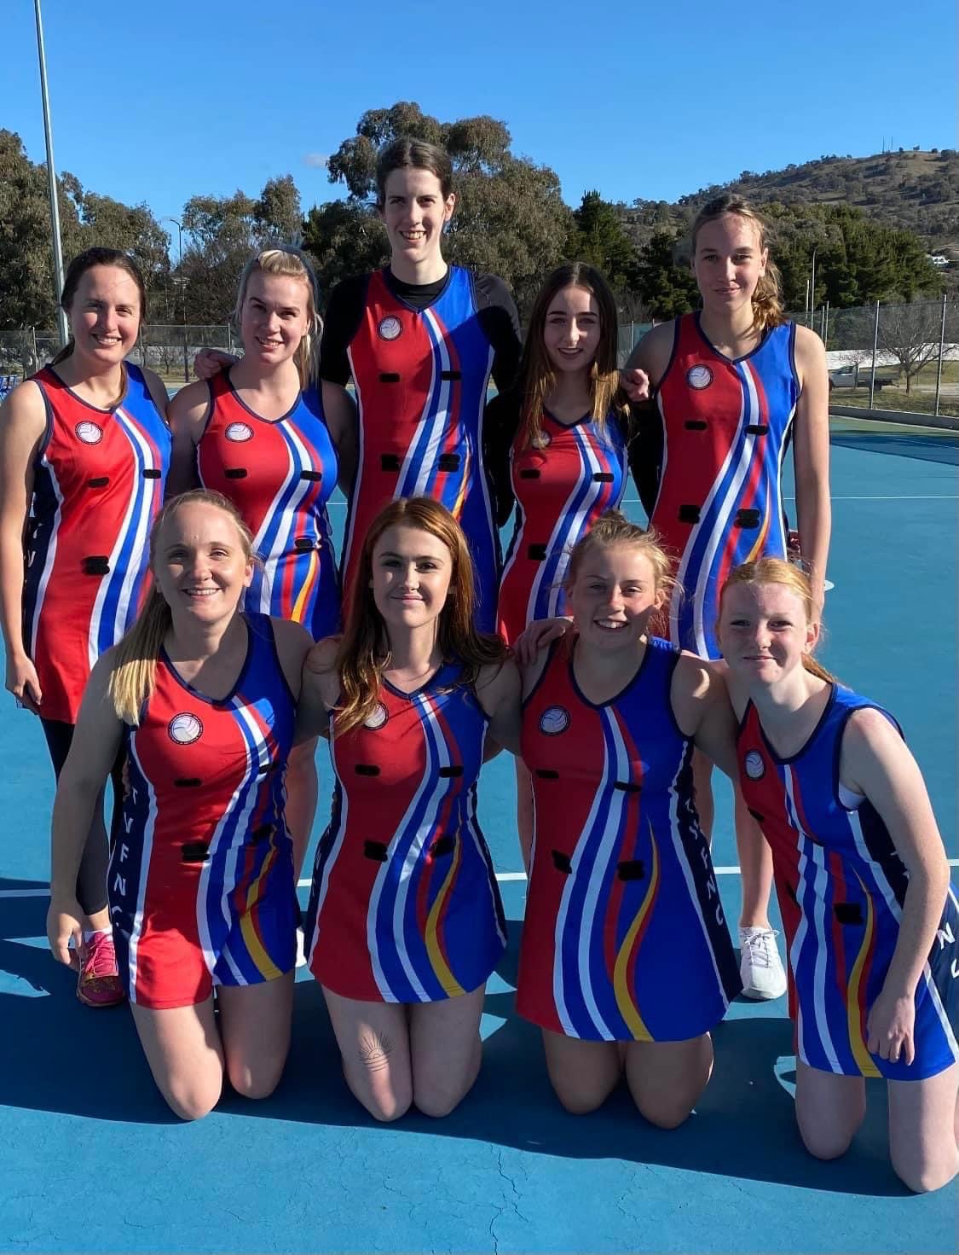
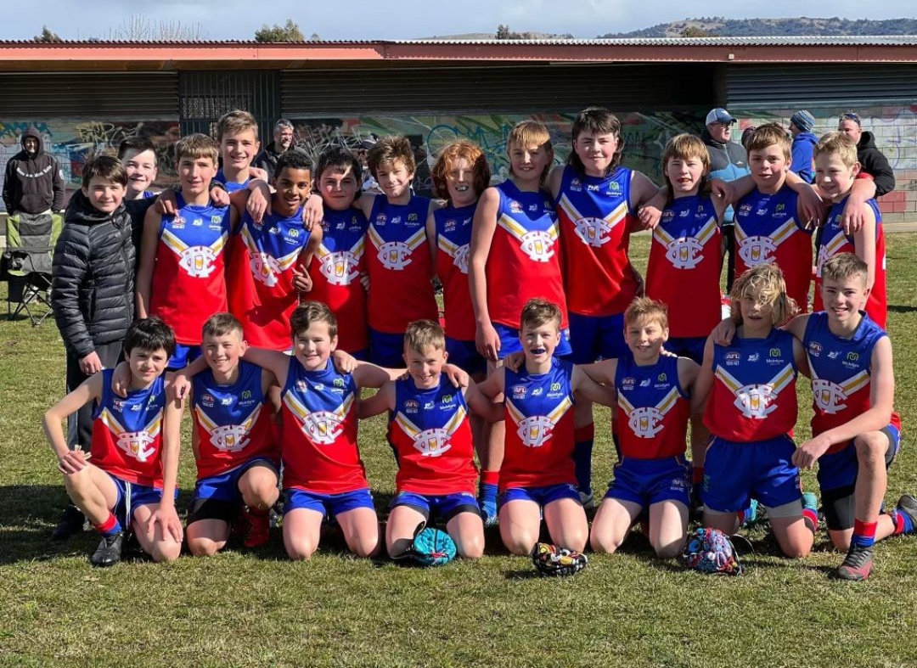
Team Sponsorships ($850 + GST)
TEAM SPONSORSHIPS AVAILABLE NOW!!
The Tuggeranong Valley Australian Football and Netball Club (TVAFNC) provides the Tuggeranong Community with a great sporting club atmosphere and environment.
Team sponsorship, available for teams Junior Football and Netball, gives you exposure to over 800+ players and their families.
Help players keep playing the game they love and in return have exposure to over 800+ players and their families
As a team sponsor you will receive:
Listed as a Netball or Junior Football team partner on the TVAFNC website and promoted in the TVAFNC newsletter.
Signage displayed at the Netball or Junior Football team homes games - to be provide by sponsor.
Sharing of news feeds on TVAFNC social media platforms.
Opportunities to market products, services or exclusive offers to the TVAFNC community.
Ticket to TVAFNC Sponsors and Life Members Day.
VIP invitation to all official Junior Football or Netball club events and acknowledgement as a Netball or Junior Football Team team Partner.
www.tuggeranongfc.com.au
Email: sponsorship@tuggeranongfc.com.au

Slide 2
TVAFNC TEAM SPONSORSHIP FORM
If you would like to sponsor a team, please complete this form and email it to sponsorship@tuggeranongfc.com.au with a high-resolution logo and a short summary of your company that can be promoted to the community.
TEAM DETAILS
Team Name:
SPONSOR DETAILS
Company Name:
ABN:
Contact Person:
Contact Person Mobile:
Contact Person Email:
Website:
Facebook:
Instagram:
PAYMENT
Bank transfer is the preferred payment method, for other payment options please email sponsorship@tuggeranongfc.com.au
Tuggeranong Valley Football and Netball Club
BSB: 082 902
Acc. No: 413 086 113
A tax invoice will be issued on payment.
Thank you for your support
www.tuggeranongfc.com.au
Email: sponsorship@tuggeranongfc.com.au

